Slide 1
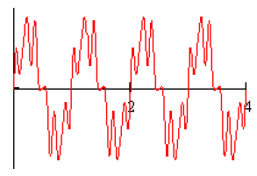
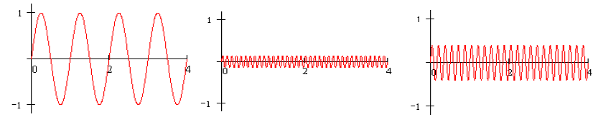
Fourier Series
  For any periodic function f(t), how to extract the component of f at a specific frequency?
is composed of the following components

Slide 2
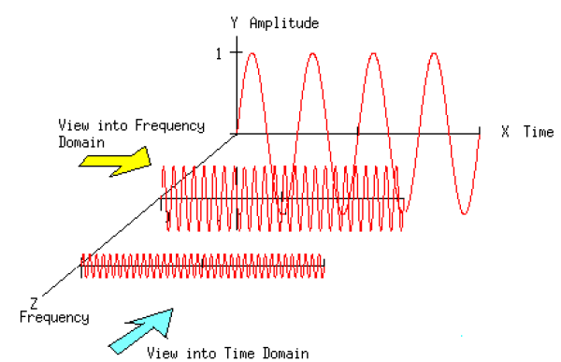
Fourier Series
  For any periodic function f(t), how to extract the component of f at a specific frequency?

Slide 3
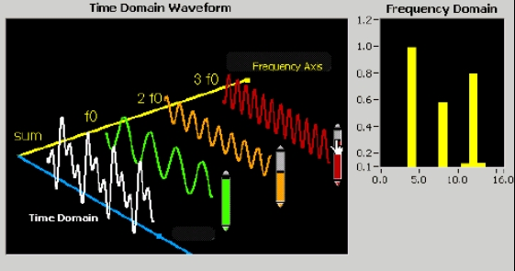
Fourier Series
  For any periodic function f(t), how to extract the component of f at a specific frequency?

Slide 4
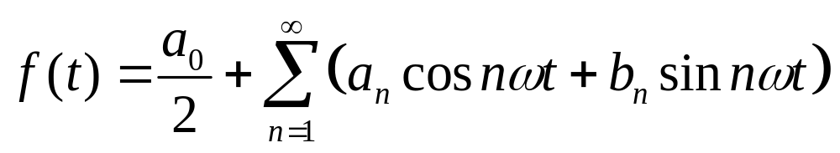
Fourier Series
  For any periodic function f(t), how to extract the component of f at a specific frequency?
Fourier Series
Any periodic function can be expressed as a sum of sines and cosines of different frequencies each multiplied by a different coefficient
more details

Slide 5

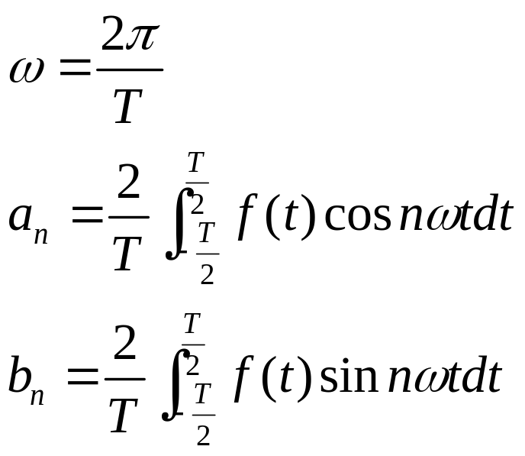
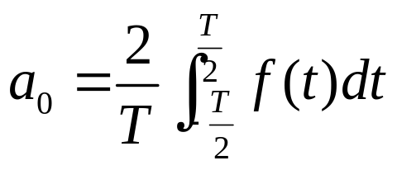
Fourier Series
For a periodic function , with period T
Fourier Series
where
Redundant!
,

Slide 6
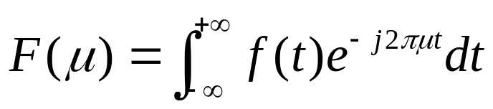
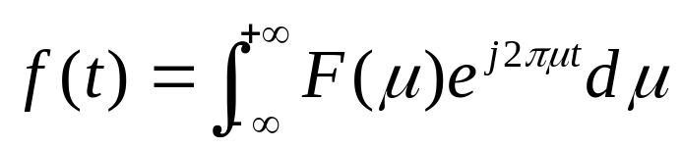
Fourier Transforms
Fourier transform of f(t) (maybe is not periodic) is defined as
Inverse Fourier transform
How to get these formulas?
Let’s start the story from Fourier series to Fourier transform…

Slide 7
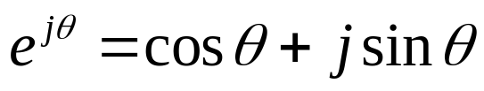
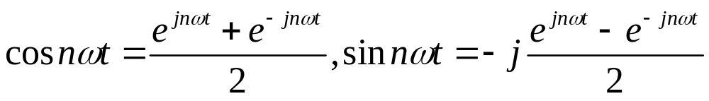
From Fourier Series to Fourier Transforms
According to Euler formula
Easy to have
Then, Fourier series become

Slide 8
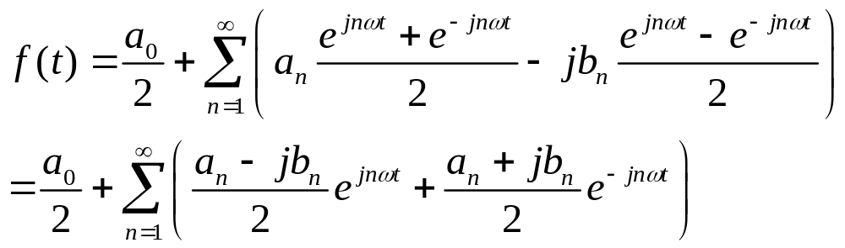
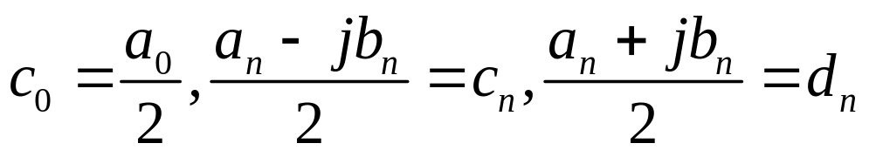
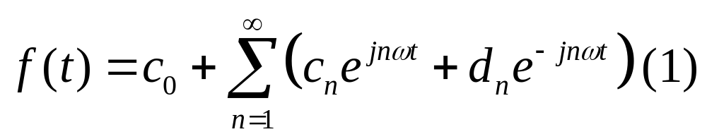
From Fourier Series to Fourier Transforms
According to Euler formula
Easy to have
Then, Fourier series become
Then, let
Then,

Slide 9
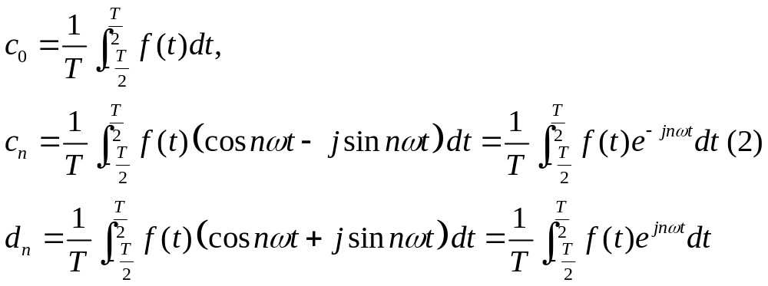
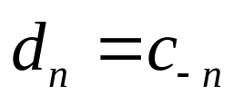
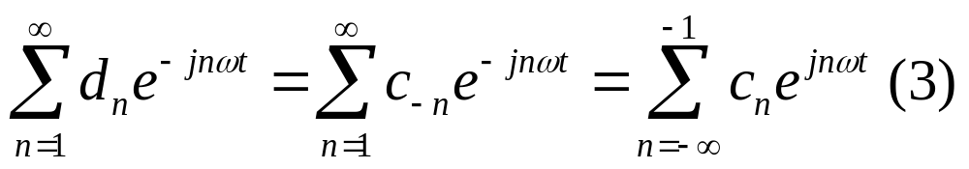
From Fourier Series to Fourier Transforms
We can see that
Thus,

Slide 10
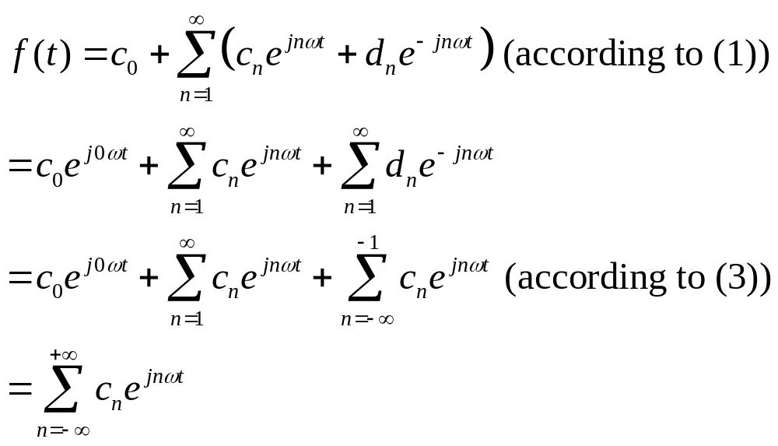

From Fourier Series to Fourier Transforms
,where is defined by (2)
This is the Fourier series in complex form
How about a non-periodic function?

Slide 11

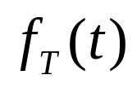
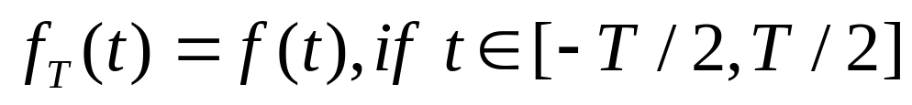

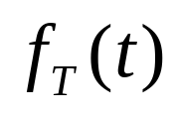
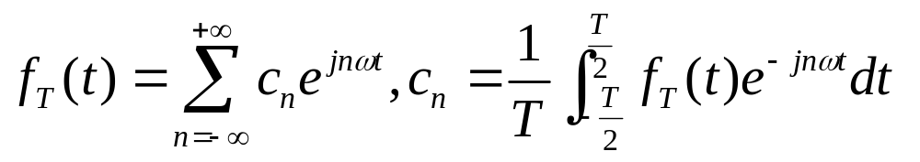
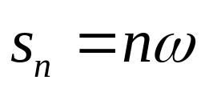
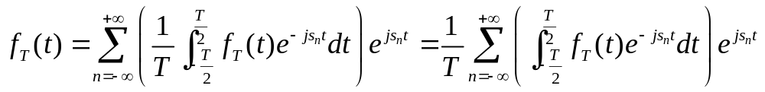
From Fourier Series to Fourier Transforms
is a non-periodic function
We make a new function which is periodic and the period is T
If , becomes
According to Fourier series
Let

Slide 12
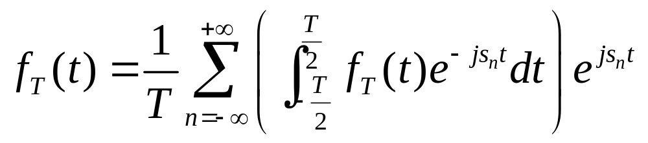
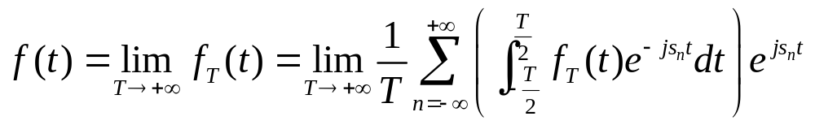
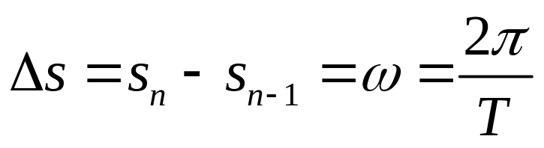
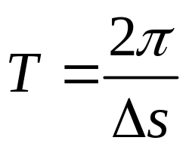
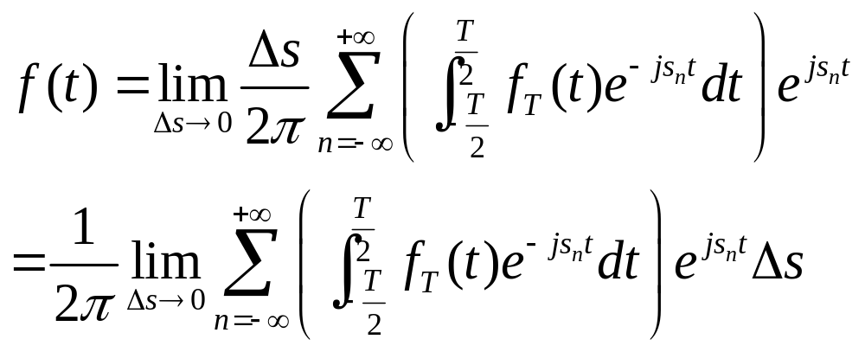
From Fourier Series to Fourier Transforms
when

Slide 13
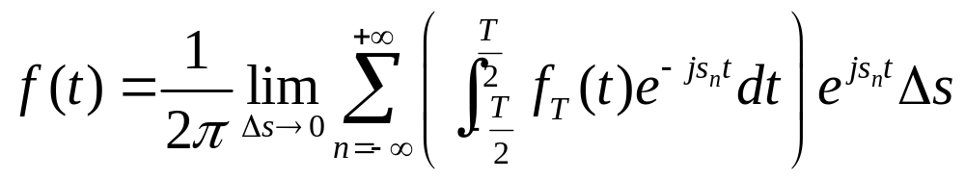
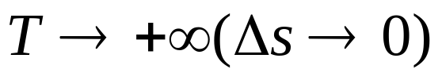

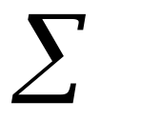
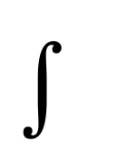



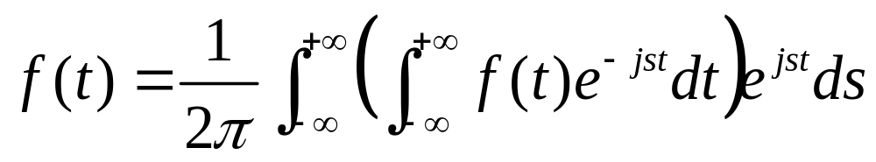
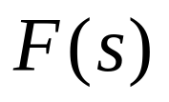
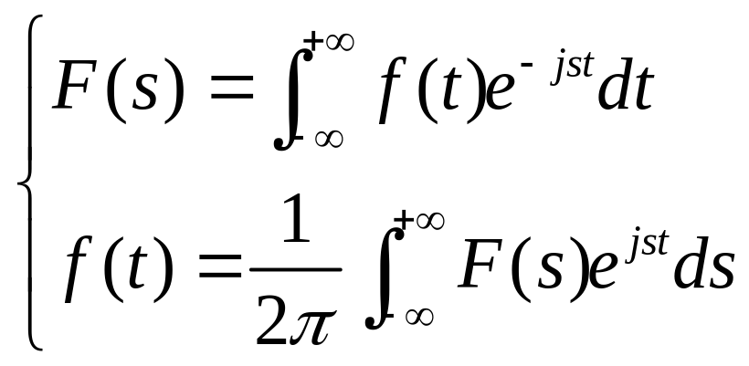
From Fourier Series to Fourier Transforms
when
,
,
Denote by
Fourier transform
Inverse Fourier transform

Slide 14


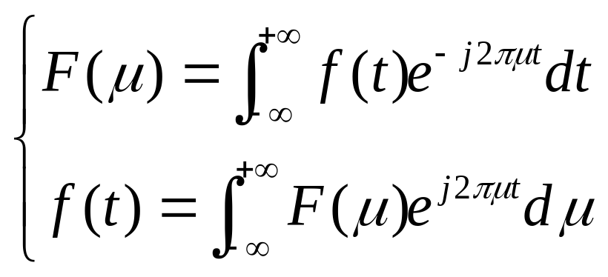
From Fourier Series to Fourier Transforms
s here actually is the angular frequency
In the signal processing domain, we usually use another form by substituting s by , where is the frequency (measured by Herz)

Slide 15
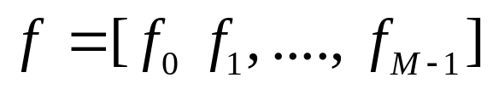

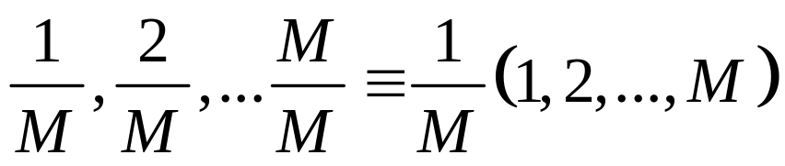
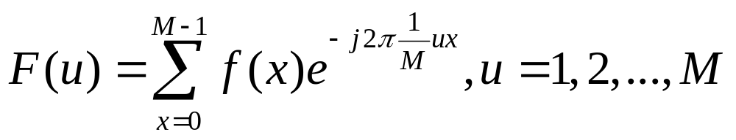
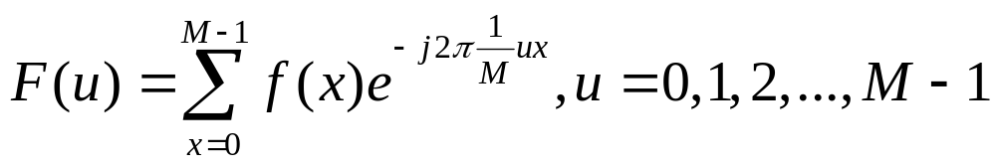
Discrete Fourier Transform (DFT) in 1D Case
Given a discrete sequence with M points
Regard it as a periodic signal, thus its basis frequency is
For its frequency components, the frequencies are,
Its DFT is computed as
Usually, we write it as,

Slide 16
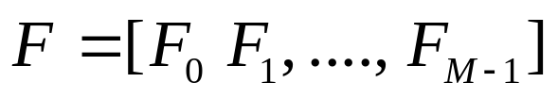
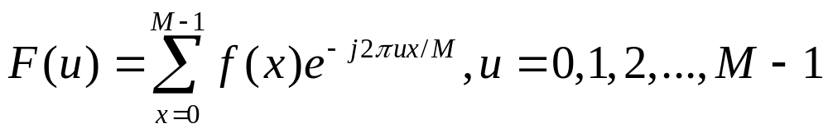
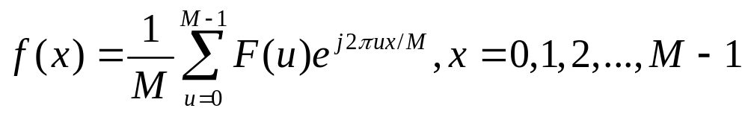
Discrete Fourier Transform (DFT) in 1D Case
Thus, f’s DFT also has M points
and
IDFT
For DFT, there is a fast algorithm for computation, FFT (Fast Fourier Transform)

